Slide 1
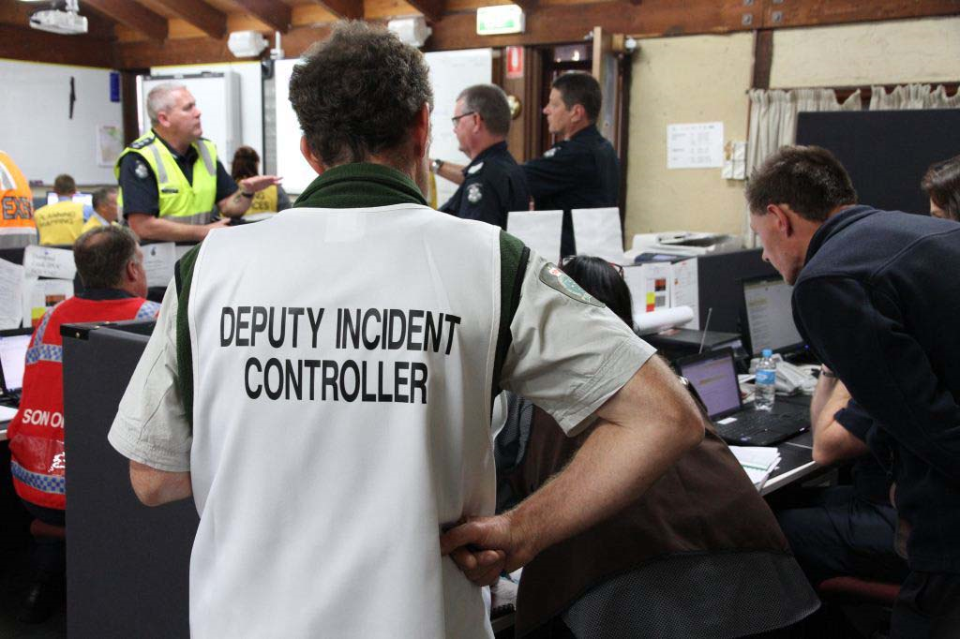

MULTI-AGENCY AIIMS
BE ready for the worst - Be trained by the best
For more than two decades, the Australasian Inter-Service Incident Management System (AIIMS) has been recognised as the foundation for managing emergency incidents in Australia and New Zealand.
‘Multi-Agency AIIMS’ is 3 day program that focuses on the development of core knowledge and adaptable skills related to the application of AIIMS and how it applies to an ‘All Hazards, All Agencies’ approach to managing emergency incidents. Participants will also complete a complementary sessions in human factors, incident communication and leadership
and teamwork.
Learning outcomes:
This program comprises the following topics:
AIIMS principles
About incidents and incident management
Incident Action Planning
The Control function
The Planning function
The Intelligence function
The Public Information function
The Operations function
The Investigation function
The Logistics function
The Finance function
Human factors and incident management
Communication
Incident information
Leadership and teamwork
COURSE ASSESSMENT:
There are three assessment activities in this program:
Multiple Choice questions
Role play scenarios
Workshop participation
WHO SHOULD ATTEND?
Personnel from any agency with either a responsibility for managing emergency incidents or who support communities through preparedness or recovery coordination. This program is also relevant for businesses looking to develop a strategy for business continuity.
COURSE details
Course: 22459VIC – Course in the Australasian Inter-Service Incident Management System (AIIMS) Duration: 3 days Delivery method: Face-to-face Location: National Centre for Emergency Studies TAFE NSW Wollongong Foleys Lane, Wollongong NSW Contact: Michelle Lieschke Phone: 02 6058 2730 Email: NCEMS@tafensw.edu.au
Please note: TAFE NSW courses are run to demand. Information contained in this document was accurate and current at the time of publication - December 2019. ABN 93-727-663-084 RTO 90003.

